Slide 1
BASIC COMPUTER USAGE
Things to know before installing Windows OS

Slide 2

OBJECTIVES FOR TODAY
What is USB bootable device?
Why do we need it?
Preparing USB boot device
Partitioning Overview
Boot process

Slide 3


ENGAGE
WHAT IS OPERATING SYSTEM (OS) ?
5 MIN
What does OS do in computer?
How many kind of OS?
What do need to setup new OS on a computer?
Have you ever heard about Flash Boot?

Slide 4



WATCH & THINK
Watch the video to understand Operating System
10 MIN
Notes:
https://www.youtube.com/watch?v=fkGCLIQx1MI

Slide 5

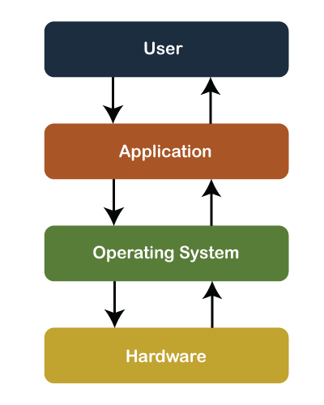
EXPLAN
About Operating System
5 MIN
An operating system is the most important software that runs on a computer.
It’s a system software that manages computer hardware and software resources and act as the interface between a user and hardware.
Without an Operating system, a computer is useless.
Notes:
What is OS?
What OS does in computer?
What type of OS?
https://edu.gcfglobal.org/en/computerbasics/understanding-operating-systems/1/#

Slide 6

EXPLAN
Operating System’s Job
5 MIN
Most of the time, there are several different computer programs running at the same time, and they all need to access your computer's CPU, RAM, and storage. The operating system coordinates all of this to make sure each program gets what it needs.
The 4 main function of Operating system:
Providing an user interface
Managing Files
Managing applications
Manage hardware
Notes:
What is OS?
What OS does in computer?
What kind of OS?
https://edu.gcfglobal.org/en/computerbasics/understanding-operating-systems/1/#

Slide 7
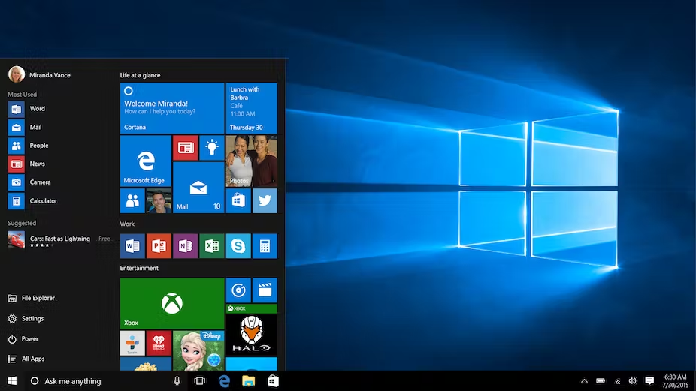
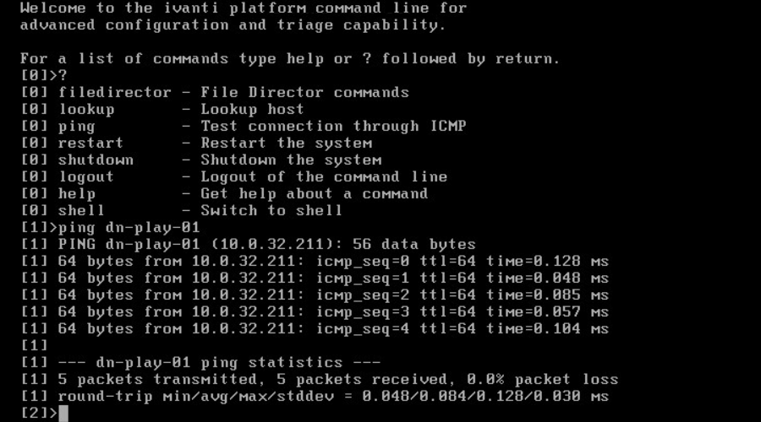
EXPLAN
Operating System’s Job
1
5 MIN
Providing a user interface: allow you to interact with computer by command line user interface (CLI) or graphic user interface (GUI).

Slide 8
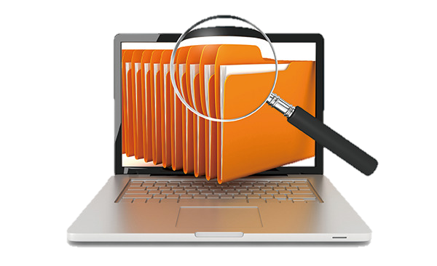
EXPLAN
Operating System’s Job
2
5 MIN
Managing Files: allow you to store, delete, copy, move and share files.
Example:
You can store file on your computer
You can create, delete, copy or move to other folder.

Slide 9
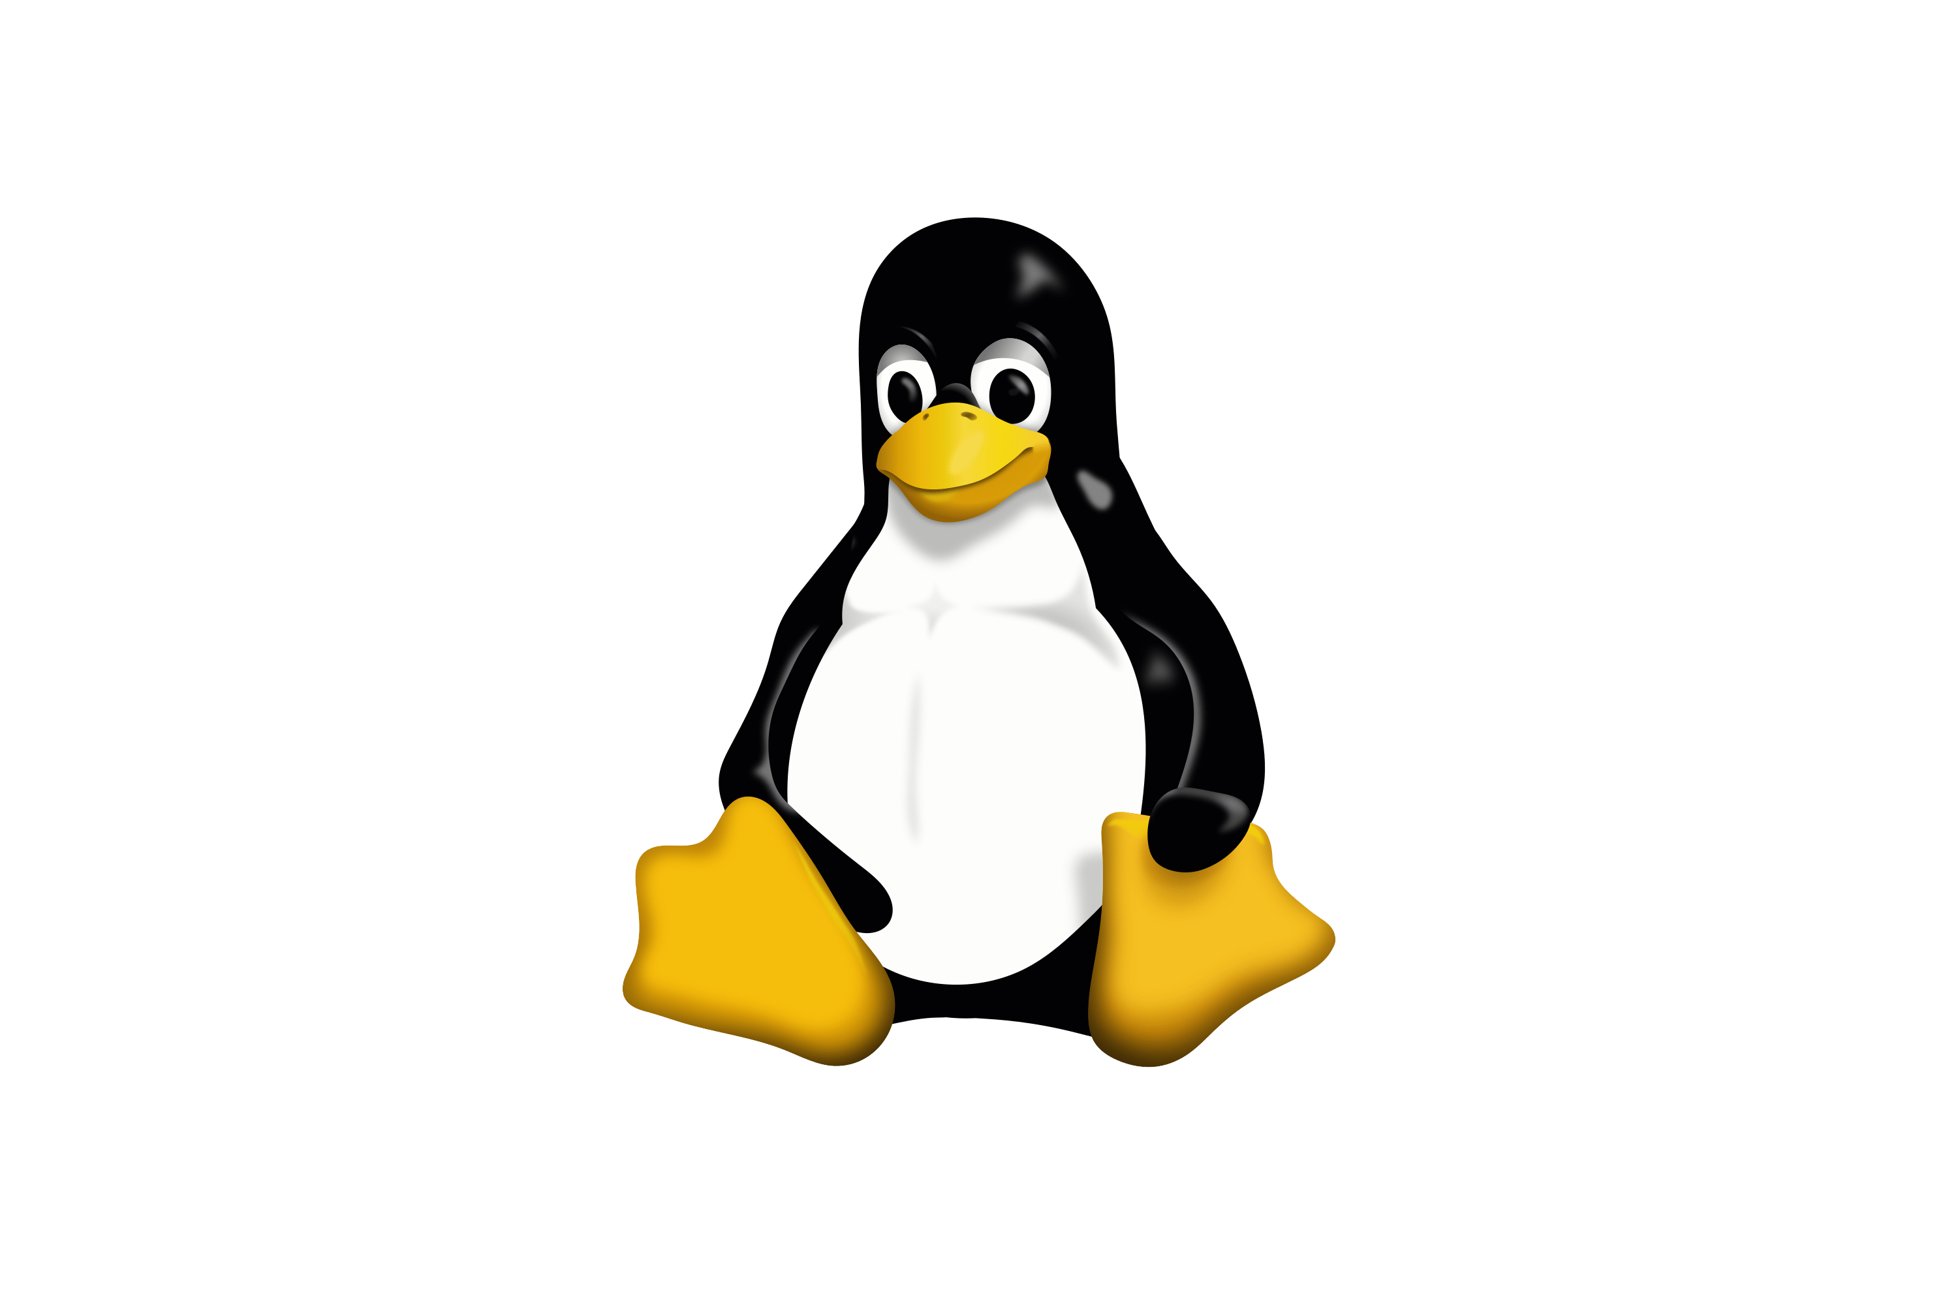
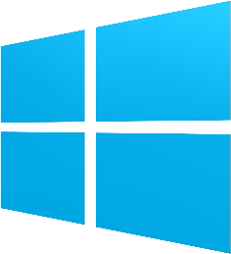
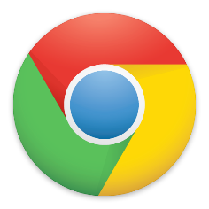


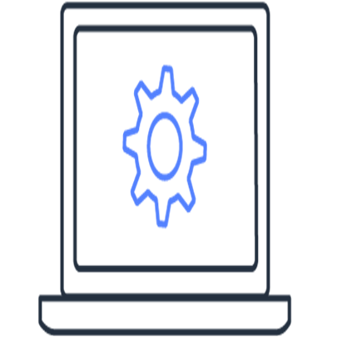
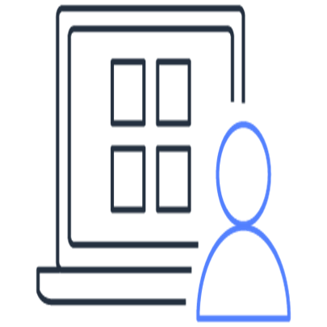
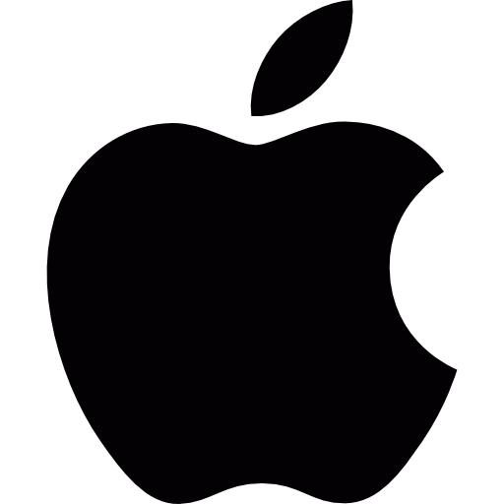
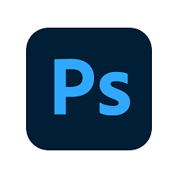



EXPLAN
Operating System’s Job
3
5 MIN
Managing applications: Operating system allow you to install, uninstall and manage system and software application.
Systems software the programs that required for system to operate as designed, include the operating system and device drivers.
Application software, or simply applications, is a set of computer programs designed for end-user to perform task.

Slide 10
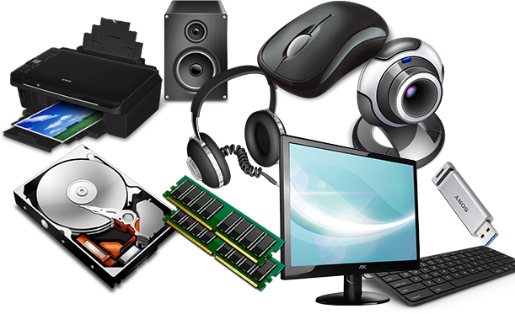
EXPLAN
Operating System’s Job
4
5 MIN
Managing hardware: Operating system mange the computer’s memory (RAM), processor (CPU) and other hardware devices that connected to computer (mouse, keyboard, disk drive…).
Example:
It allows CPU to process the program software.
It allow you to connect the USB flash drive
It allow you to play a song and output the sound through speaker

Slide 11





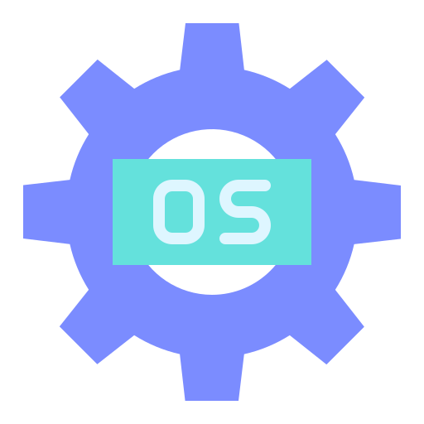
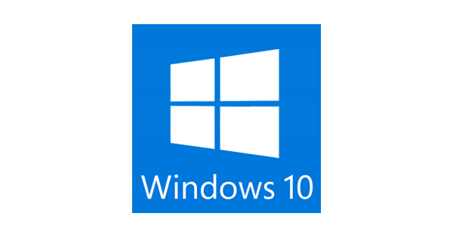
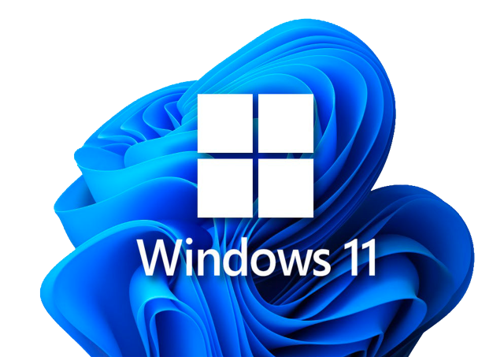
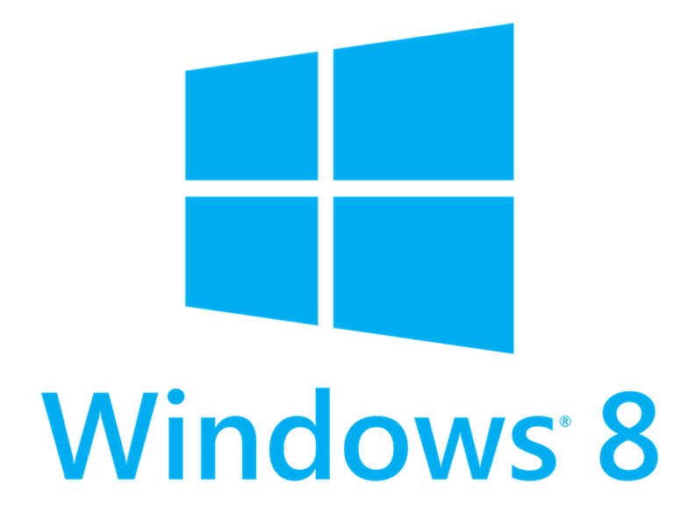
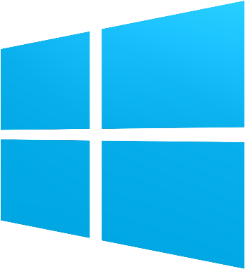
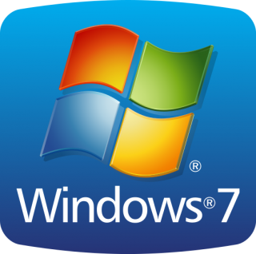
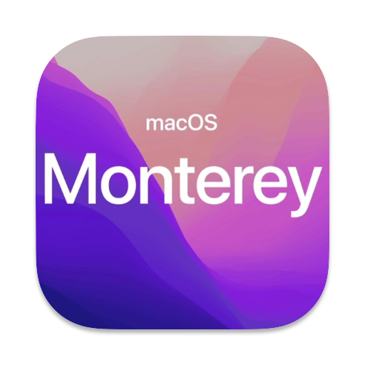
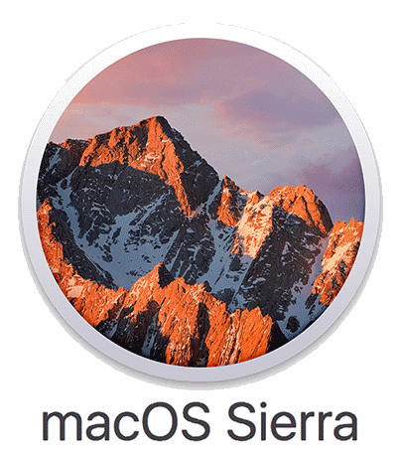
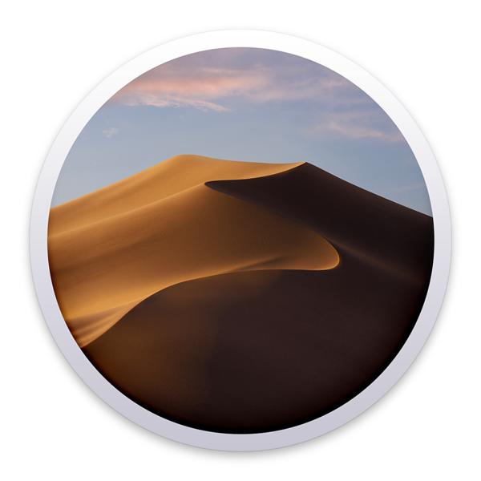
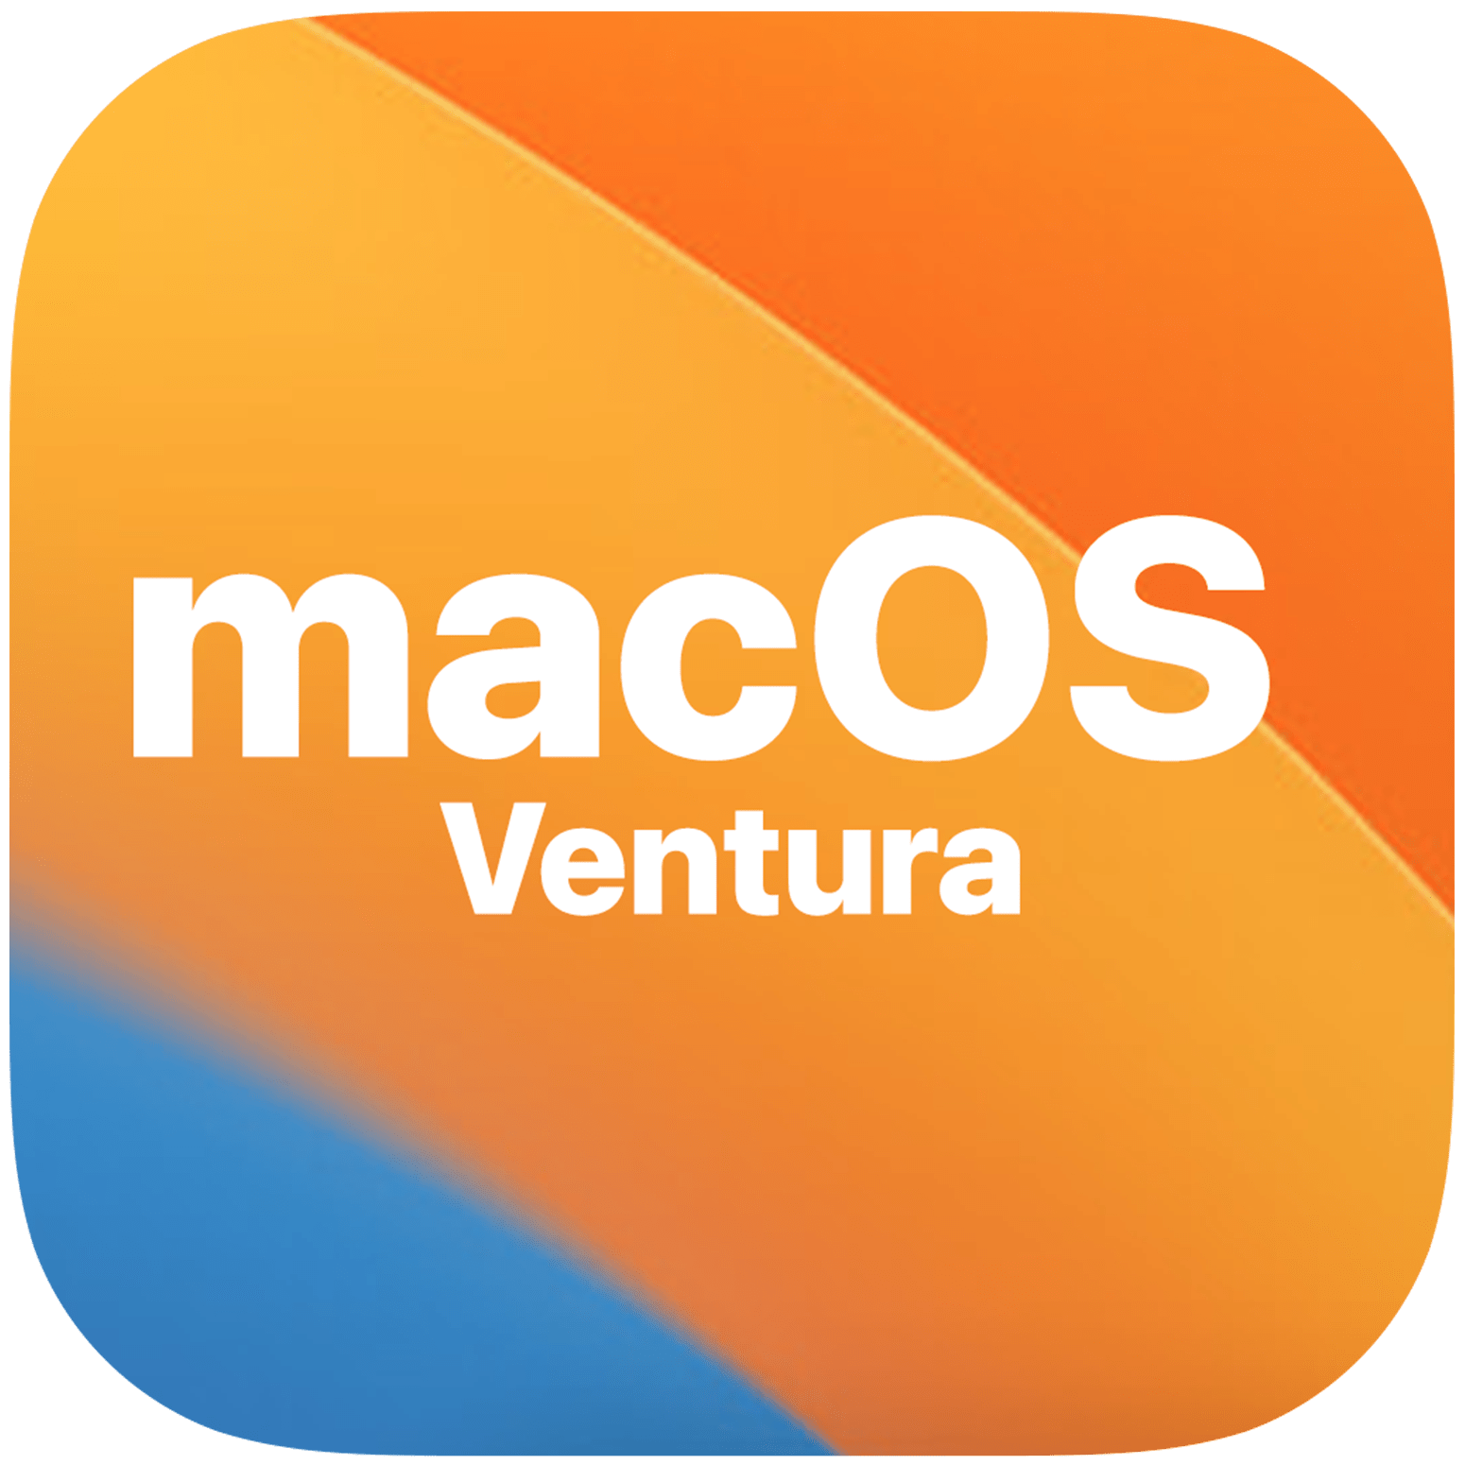
EXPLAN
Type of Operating System
2 MIN
Linux
Microsoft Windows
MacOS
macOS Mojave

Slide 12

Booting process

Slide 13

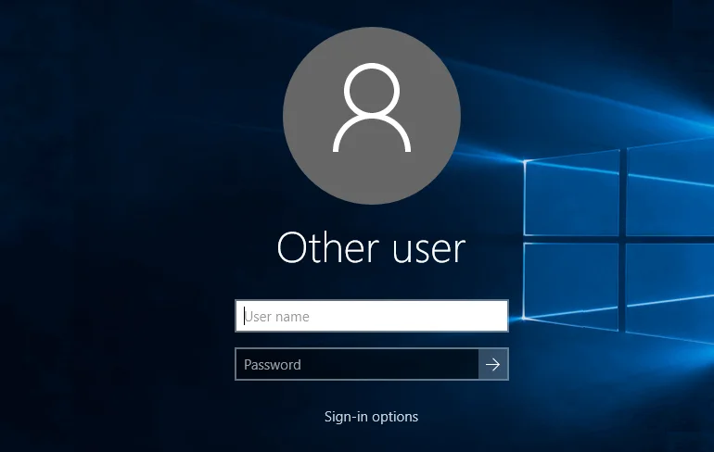
EXPLAN
PC Booting Process
2 MIN
What is Boot?
A “Boot” (also "to boot up") a computer is to load an operating system into the computer's main memory or RAM in order to start up the computer.
Notes:
- Review RAM, CPU, HDD

Slide 14
EXPLAN
About the Booting Steps
10 MIN
The steps of the boot process are:
Step
Step
1
Step
1
Step
1
Step
1
1
2
3
4
5
Power on the computer.
Activate the Basic Input/Output System (BIOS).
Run the power-on self-test (POST).
Locate and load the OS to RAM.
Transfer control to the OS.
Notes:
Computer Booting Process
Step 1: The basic input/output system (BIOS) is activated (Press on power button)
Step 2: A Power-on self-test (POST) checks attached hardware to make sure it works
Step 3: The operating system loads into memory from boot device (from HDD by default)
Step 4: Configuration and customization settings are checked
The BIOS goes through a POST, or Power-On Self Test, before booting your operating system. It checks to ensure your hardware configuration is valid and working properly.

Slide 15
EXPLAN
Hardware Requirements to install OS
2 MIN
You can identify differences from one Operating Systems to one Operating Systems by system requirements and characteristics:
4
2
5
3
1
License
RAM
Support
Hard Disk Space
CPU
Notes:
Laptop
USB Flash / CD /DVD
ISO file
Hardware requirement to install Windows

Slide 16
EXPLAN
Hardware Requirements to install OS
2 MIN
Windows Clients Operating Systems
Description | Windows 7 | Windows 10 | Windows 11
Requirement of RAM | 2GB | 4GB or more | 4GB or more
Processor (CPU) | 1GHz | 1GHz or Faster | 1GHz or Faster
Hard Disk Space | 20GB | 20GB | 64GB or Larger
License/Pricing | 115 USD | 139$ - 199$ (life time on one device) | 139$ - 199$ (life time on one device)
Support | Yes | Yes | Yes
Notes:
Laptop
USB Flash / CD /DVD
ISO file
Hardware requirement to install Windows

Slide 17
EXPLAN
Hardware Requirements to install OS
2 MIN
Linux Operating Systems
Description | Ubuntu/Debian | Redhat/Centos | Open SuSE
Requirement of RAM | 1 GB | 1 GB | 1GB
Processor (CPU) | 700 MHz | 500 MHz | 500 MHz
Hard Disk Space | 15 GB | 10 GB | 10 GB
License/Pricing | Free | 96 USD/year | Free
Support | No | Yes | No
Notes:
Laptop
USB Flash / CD /DVD
ISO file
Hardware requirement to install Windows

Slide 18
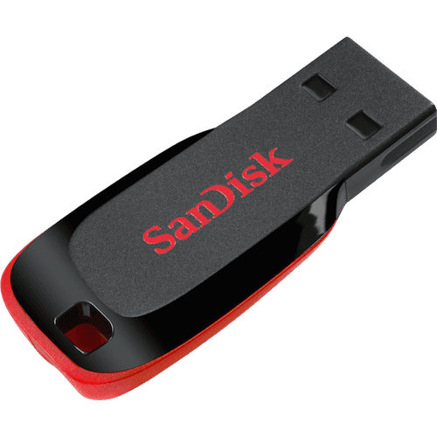
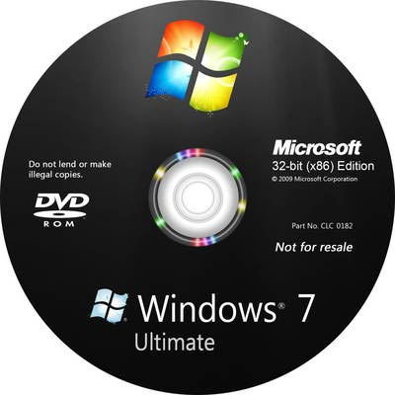
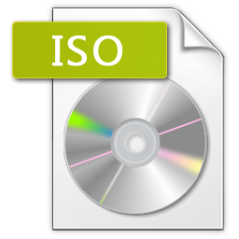

EXPLAN
What do you need to prepare for set up new OS?
3 MIN
Material for creating bootable media (flash boot)
USB Flash drive / CD or DVD
OS image file (ISO)
Software for creating flash boot
Computer (Laptop/desktop)

Slide 19
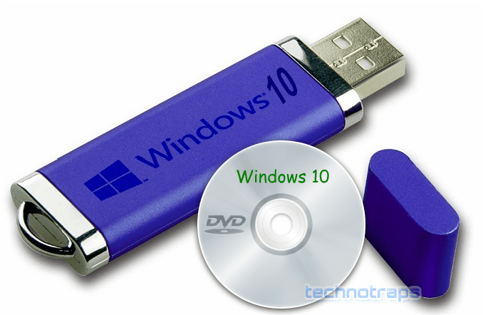
EXPLAN
Bootable Media
5 MIN
What is Bootable Media?
“Bootable media” is storage device that contains special files required for the computer to boot into an operating system. Bootable media can be Hard disk, USB flash, CD, DVD, external hard disk etc.
Notes:
What is flash boot?
How to create flash boot?

Slide 20
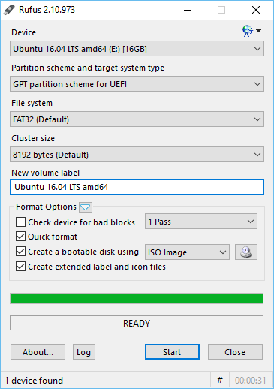
EXPLAN
How to create USB Flash Boot?
10 MIN
Bootable USB Flash drive by software (Rufus)
Download: https://rufus.akeo.ie/
Run Rufus software
Insert USB flash drive
Brows ISO image
Click start button
Note: USB Flash will be formatted (everything that stored will be deleted)

Slide 21
WATCH & THINK
Watch the video to know how to download Windows ISO file
5 MIN
Notes:
https://www.youtube.com/watch?v=fkGCLIQx1MI
https://getintopc.com/softwares/operating-systems/page/10/

Slide 22

ENGAGE
2 MIN
What is Partition?
Notes:
What is partition in Windows
Why do we need to partition a hard disk?
How many partition in Windows we should have?

Slide 23
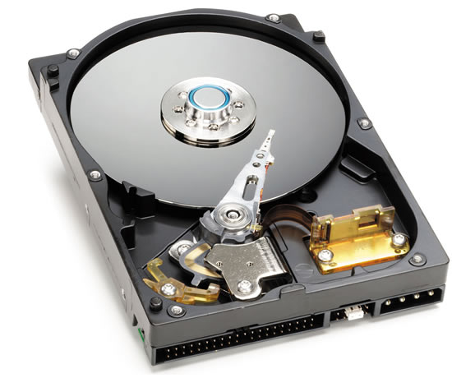
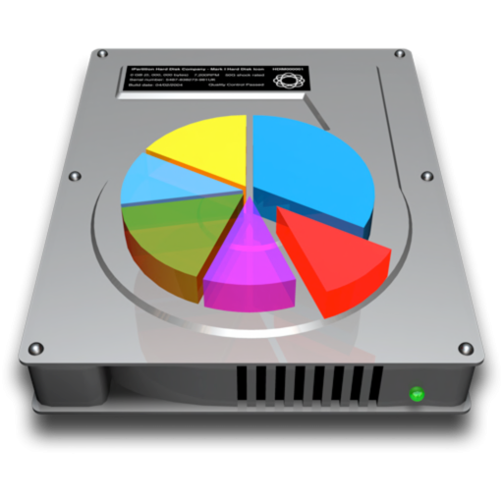
EXPLAN
Partitioning Overview
5 MIN
When a hard disk is installed in a computer, it must be partitioned before being formatted and then used. You cannot use it immediately when you buy it and install it in a computer.
Once a partition is created, it can be formatted so it can be used.
Notes:
Why you need to format you storage device?
To choose file system like NTFS (to manage how data is stored on device)
To choose drive letter like drive C: D: E:
_{To set label of device}
(These information are required on a storage device)

Slide 24
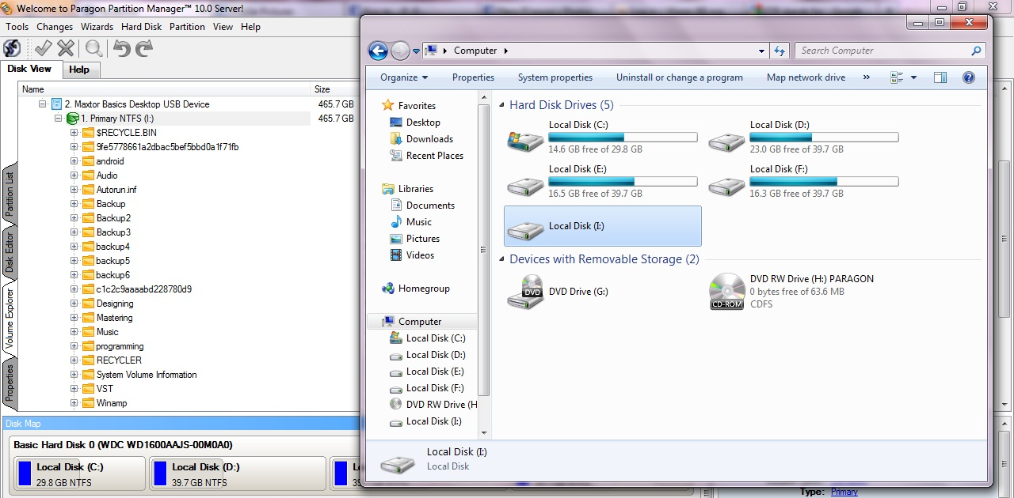
EXPLAN
Partitioning Overview
5 MIN
Disk partitioning is the way to divide a physical hard disk into multiple logical storage units.
Example: Drive C: or D:

Slide 25
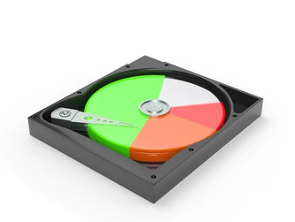
EXPLAN
Purpose of Partition
5 MIN
Better organize your data.
Run different operating systems on one PC.
Reduce the possibility of data loss.
More convenient for backup and restore.
Improve performance.
Pictures
H:
D:
Movies
C:
OS & Applications
E-Learning
G:
Notes:
- Different partition store different kind of data.

Slide 26
EXPLAN
Type of Partition
5 MIN
Boot partition: it is also a primary partition which used to contains the operating system.
Primary partition : it’s a partition that is used to store the normal data file such as picture, video, sound, document files and etc.
System partition: it is a primary partition that contains the boot loader, a piece of procedure responsible for booting the OS. It’s default created by system computer.

Slide 27
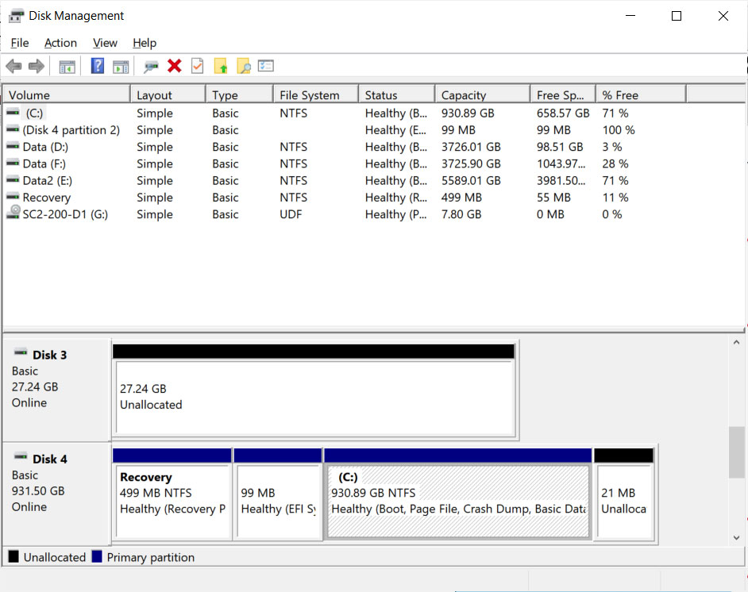
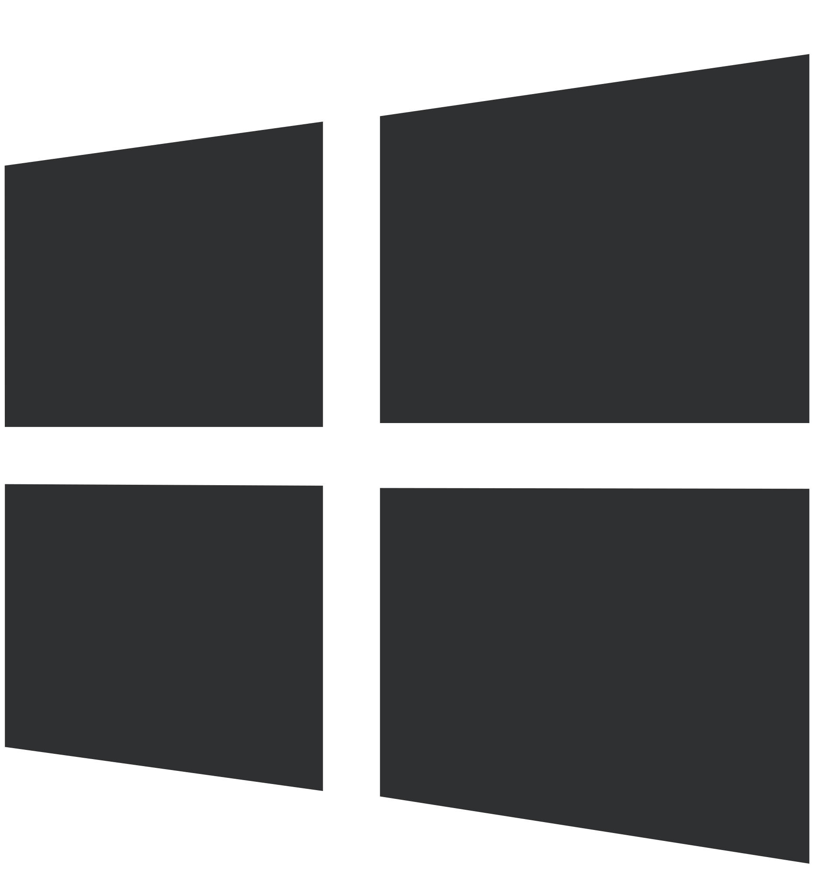
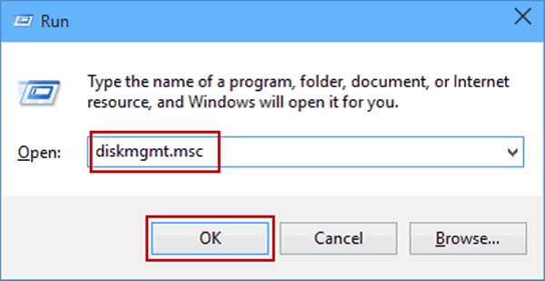
EXPLAN
How to create partition on Windows
5 MIN
+ R > type “diskmgmt.msc”

Slide 28
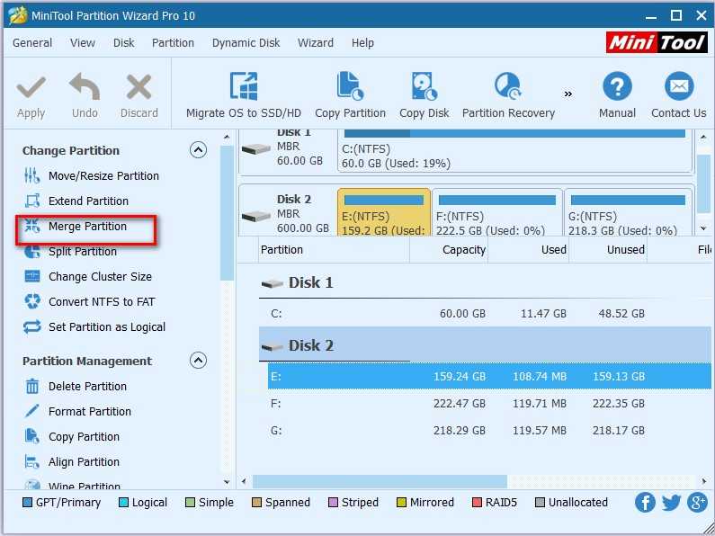
EXPLAN
How to create partition on Windows
5 MIN
MiniTool partition
Wizard Free software

Slide 29

What is Operating system?
What does Operating system do in computer?
How many kind of Operating system? What are they?
What do you need to prepare before starting to install OS on a computer?
What is a partition? What kind of partition?
Why do we need to partition our hard disk drive?
How many partition should we create on our computer?

